Slide 1
Job Counseling System

Slide 2
TEAM MEMBERS
Syed Mohsin Ali Naqvi (CS-151159) (Team Lead)
Syed Nabeel Danish (CS-142007)
Muhammad Noman Memon (CS-131030)

Slide 3
SUPRVISOR
Miss Umema Hani

Slide 4
INTRODUCTION
The problem we are addressing with our system has been haunting graduates since a long time. What are the suitable jobs where my required skills suits the best? Well, our system is designed to tackle this very question.
The system will be integrated with data feeds of Company and User LinkedIn profiles. Each Job Definition from the profile will evaluated and classified by appropriate machine learning algorithm to help students and fresh graduates in their job counseling and by generating generic job areas with possible required skills.
Students can use generated counseling results inorder to acquire desired technical skills whereas university management can utilize results inorder to fit students under appropriate subjects.

Slide 5
MOTIVATION
The motivation behind developing this system is to make an attempt towards doing generic job counseling for students and graduates.
As this domain requires a proper intelligent counsellor that can be meeting the rapidly changing job trends, hence there are some substitutes which either focusing on giving answers to students queries by the experts themselves or giving direct replies to students queries or just have contact info by career counsellors for conducting seminars
But there are no suitable solution to solve the current problems. Very little work has been done in this area.

Slide 6
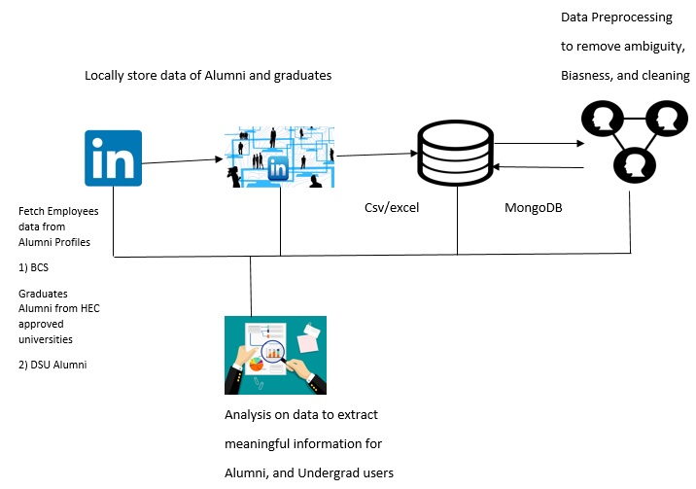
ABSTRACT

Slide 7
OBJECTIVES
To counsel students during their studies in order to get early idea of what current Job and skill trends are being followed in the market.
To find out most relevant job category and required skills in CS.
To be used by the university in order to adjust the latest trends in different courses.

Slide 8
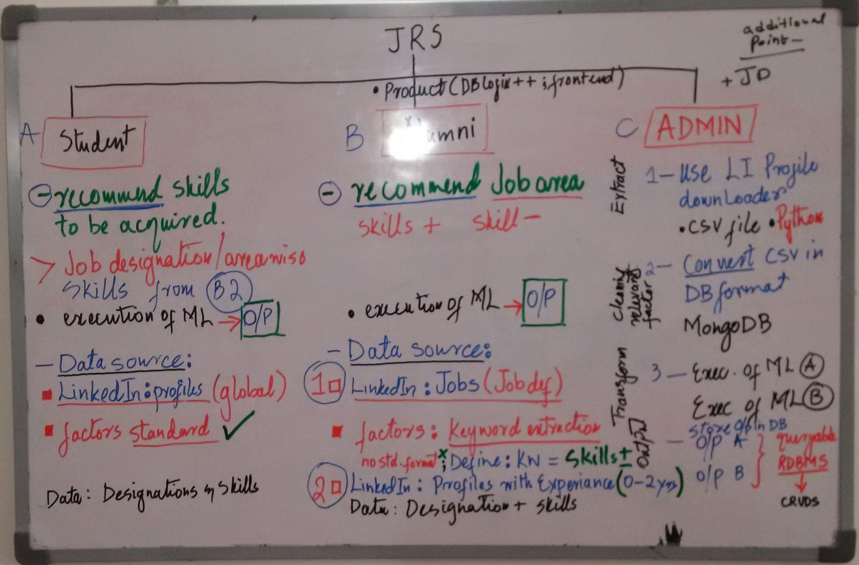
BRAINSTROMING
Alumni

Slide 9
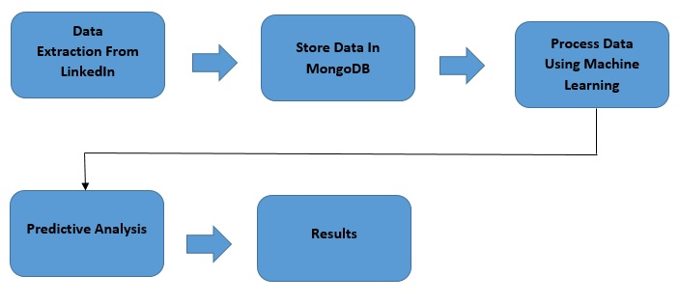
METHODOLOGY OF ANALYTICAL PART

Slide 10
Handling of Fake Profiles vs Real Profiles
Fake profiles often tell you like their so they can get profile on the other hand real profiles don’t ask for these kind of things so add filters that filter out these kind of profiles.
Fake profiles don’t have proper information or any other relevant information just post random information.

Slide 11
PROJECT DELIVERABLES
Phase I - Alpha Prototype
Developed and Application which extract data from LinkedIn. This work will be submitted in the third hourly of project 1.
Phase II - Beta Prototype
The Data which we extracted from LinkedIn is stored in Database. This is the second phase of our project which will be submitted in final of project 1.
Phase III - Release Candidate
Apply Machine learning on data which we stored in Database and analyzing the data. This is the second last phase of Project which will be submitted in second hourly of project 2.
Phase IV - Final Product
Submit the complete application with correct result (fulfill all requirements).The last phase of Project which will be submitted in last.

Slide 12
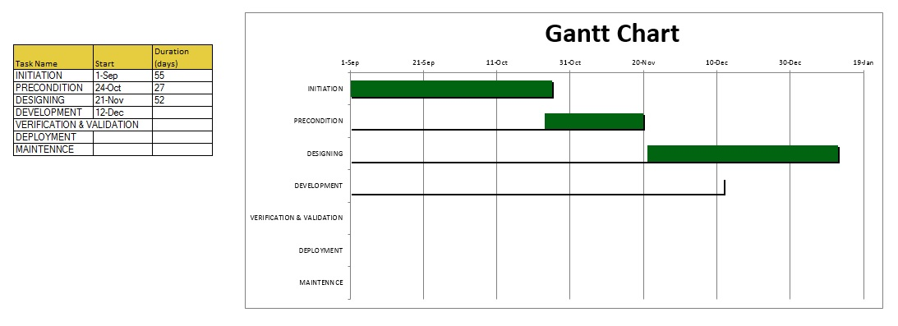
MILESTONES
80% Complete

Slide 13


